Slide 1
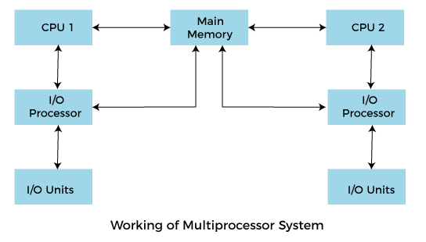
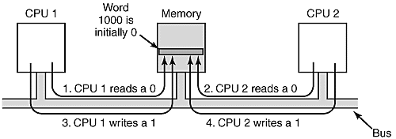
Multiprocessor synchronization
Multiprocessor system facilitates parallel program execution and read/write sharing of data and thus may cause the processors to concurrently access location in the shared memory. Therefore, a correct and reliable mechanism is needed to serialize this access.
This is called synchronization mechanism.

Slide 2
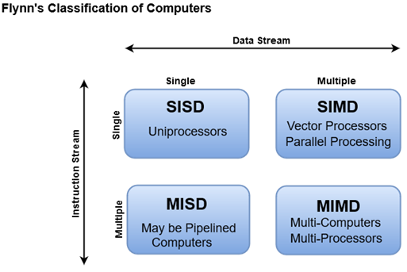
flynn classification
Flynn's Classification refers to a classification of parallel computer architectures. Parallel computers can be classified by the concurrency in processing sequences (streams), data, or instructions from the perspective of an assembly language programmer.
The sequence of instructions read from memory constitutes an instruction stream.
The operations performed on the data in the processor constitute a data stream.
Flynn's classification divides computers into four major groups that are:

Slide 3
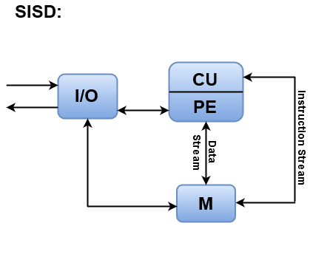
SISD
SISD stands for 'Single Instruction and Single Data Stream'. It represents the organization of a single computer containing a control unit, a processor unit, and a memory unit.
Instructions are executed sequentially, and the system may or may not have internal parallel processing capabilities.
Most conventional computers have SISD architecture like the traditional Von-Neumann computers.
Parallel processing, in this case, may be achieved by means of multiple functional units or by pipeline processing.
Instructions are decoded by the Control Unit and then the Control Unit sends the instructions to the processing units for execution.
Data Stream flows between the processors and memory bi-directionally.
Examples:
Older generation computers, minicomputers, and workstations

Slide 4
SIMD
SIMD stands for 'Single Instruction and Multiple Data Stream'. It represents an organization that includes many processing units under the supervision of a common control unit.
All processors receive the same instruction from the control unit but operate on different items of data.
The shared memory unit must contain multiple modules so that it can communicate with all the processors simultaneously.
SIMD is mainly dedicated to array processing machines. However, vector processors can also be seen as a part of this group.

Slide 5
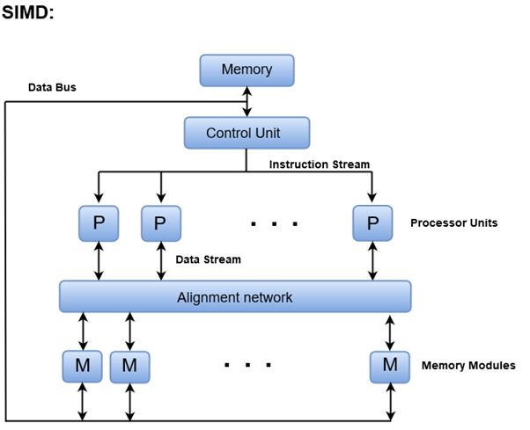

Slide 6
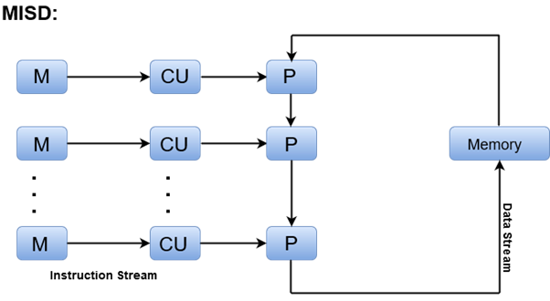
MISD
MISD stands for 'Multiple Instruction and Single Data stream'.
MISD structure is only of theoretical interest since no practical system has been constructed using this organization.
In MISD, multiple processing units operate on one single-data stream. Each processing unit operates on the data independently via separate instruction stream.
Where, M = Memory Modules, CU = Control Unit, P = Processor Units

Slide 7
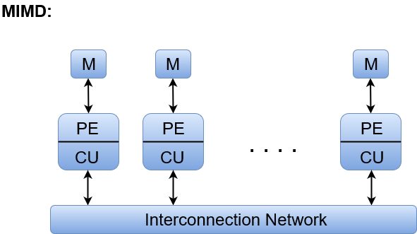
MIMD
MIMD stands for 'Multiple Instruction and Multiple Data Stream'.
In this organization, all processors in a parallel computer can execute different instructions and operate on various data at the same time.
In MIMD, each processor has a separate program and an instruction stream is generated from each program.
Where, M = Memory Module, PE = Processing Element, and CU = Control Unit

Slide 8
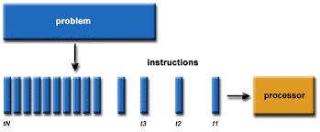
parallel computing
Parallel computing is a type of computation in which many calculations or processes are carried out simultaneously.
Large problems can often be divided into smaller ones, which can then be solved at the same time.
Parallel computing also helps in faster application processing and task resolution by increasing the available computation power of systems.
The parallel computing principles are used by most supercomputers employ to operate.
The operational scenarios that need massive processing power or computation, generally, parallel processing is commonly used there.
There are many reasons to use parallel computing, such as save time and money, provide concurrency, solve larger problems, etc. Furthermore, parallel computing reduces complexity.

Slide 9
Advantages of parallel computing
Parallel computing saves time, allowing the execution of applications in a shorter wall-clock time.
Solve Larger Problems in a short point of time.
Compared to serial computing, parallel computing is much better suited for modeling, simulating and understanding complex, real-world phenomena.
Throwing more resources at a task will shorten its time to completion, with potential cost savings. Parallel computers can be built from cheap, commodity components.
Many problems are so large and/or complex that it is impractical or impossible to solve them on a single computer, especially given limited computer memory.
You can do many things simultaneously by using multiple computing resources.
Can using computer resources on the Wide Area Network(WAN) or even on the internet.
It can help keep you organized. If you have Internet, then communication and social networking can be made easier.
It has massive data storage and quick data computations.

